Slide 1
Introduction to Interoperability
Tanzania Connect-A-Thon 2016
IntraHealth International

Slide 2

Tanzania eHealth Strategy 2013-2018
Strategic Goals
Enable more efficient use of healthcare resources through replacing paper-intensive processes and providing better information management.
Enable the health sector to operate more effectively as a connected system, overcoming fragmentation and duplication of service delivery.
Make patient care safe and effective by ensuring that the correct information is available in a timely manner, where it is needed and to whom it is needed.
Enable electronic access to appropriate healthcare services for patients in remote, rural, and disadvantaged communities.
Support improved multi-way communication and sharing of information among clinicians, patients, and caregivers within the health sectors and across partner agencies.
Support evidence-based policy, investment, and research decisions through access to timely, accurate, and comprehensive reporting of healthcare system information.
Strategic Goals
Enable more efficient use of healthcare resources through replacing paper-intensive processes and providing better information management.
Enable the health sector to operate more effectively as a connected system, overcoming fragmentation and duplication of service delivery.
Make patient care safe and effective by ensuring that the correct information is available in a timely manner, where it is needed and to whom it is needed.
Enable electronic access to appropriate healthcare services for patients in remote, rural, and disadvantaged communities.
Support improved multi-way communication and sharing of information among clinicians, patients, and caregivers within the health sectors and across partner agencies.
Support evidence-based policy, investment, and research decisions through access to timely, accurate, and comprehensive reporting of healthcare system information.
Strategic Objective 2. Establish eHealth standards, rules, and protocols for information exchange and protection.

Slide 3
Client Registry
Health Provider Directory
Master Facility List
Shared Health Record
DHIS2 (HMIS)
Core Information
Services
Logistics Management
IDSR
Electronic Medical Records
Community Based HIS
Referral Hospital
Generators Of
Information
Immunizations
TB
HIV
Malaria
Paper records
Paper records
Paper records
Paper records

Slide 4
110779-6 is the Access Medical and Dialysis Centre, ….
Client Registry
Health Provider Directory
Master Facility List
Shared Health Record
DHIS2 (HMIS)
Core Information
Services
What are the health facilities?
Logistics Management
IDSR
Electronic Medical Records
Community Based HIS
Referral Hospital
Generators Of
Information
Immunizations
TB
HIV
Malaria
Paper records
Paper records
Paper records
Paper records

Slide 5
Client Registry
Health Provider Directory
Master Facility List
Shared Health Record
DHIS2 (HMIS)
Core Information
Services
Here is the indicator for facility 110779-6
for this month
Logistics Management
IDSR
Electronic Medical Records
Community Based HIS
Referral Hospital
Generators Of
Information
Immunizations
TB
HIV
Malaria
Paper records
Paper records
Paper records
Paper records

Slide 6






Interoperabiltiy: How are these systems communicating?
The “languages” they speak (Data exchange standards)
Need agreement on languages spoken
Each component information system should decide what they need to speak
are the asking for information?
are they publishing information?
Standards Development Organizations define standards

Slide 7
Benefits of Standards
Increased Efficiency
Reduce the “data modeling” – map existing data to a standard rather than coming up with a model
Less software development time – can use existing software libraries to share data
Plug & Play
Leverage existing software technology stacks that uses the standard to provide new functionality “for-free”

Slide 8
Interoperabiltiy: How are these systems communicating?
The “meaning” of what they are saying (Terminologies and MetaData)
110779-6 is the Access Medical and Dialysis Centre (TZ MFL)
Code for Acute Kidney Failure is N17.9 (ICD-10 )
Master Facility List
Terminology Service
DHIS2 (HMIS)
What are the health facilities?
What is the code for Kidney failure?
We had 2 incidents of N17.9 at 11079-6 last month
Electronic Medical Records

Slide 9
Interoperabiltiy: How are these systems communicating?
Who are they talking with
Access control
Audit Logging
Translators
Synchronization Services
Public Access / Open Data
Protected Health Information
Master Facility List
Terminology Service
DHIS2 (HMIS)
Interoperability Layer
Electronic Medical Records

Slide 10
OpenHIM
(Interop Layer)
Health Information Mediator (HIM)
Immunization Registry
Client Registry
Tanzania eHealth Architecture
TImR
InterLinked Registry
Master Facility List
DHIS2 (HMIS)
Mobile App
OpenHIM
(Interop Layer)
DATIM
SMS App
InterLinked Regsitry
Translates MFL data into CSD standard
Ensure authorization to access data. Log all transactions.
Routine Indicator Reporting using ADX standard across multiple jurisdictions
DHIS2 (HMIS)

Slide 11
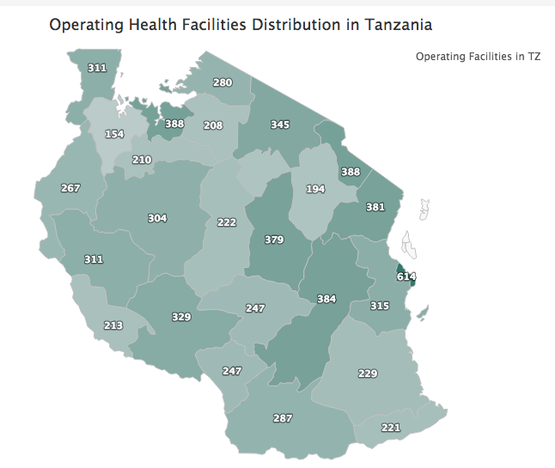
Uses of Data
Dashboards for decision making
Resource planning
Project evaluation
Prioritize interventions
Support clinical services
Decision support
Referrals
Adherence
Open data

Slide 12
Open Data and Data Standards

Slide 13
Use Case: HPD & HMIS Data Exchange
There are 2 Nurses in Plebo Clinic this month
Thank you very much!
HPD
HMIS
Collects detailed information on health workers
Wants to share number of health workers by facilities and cadre
Wants to know number of health workers by facility and cadre
Notes:
In many countries there’s a lack of health workforce data:
**on training status
**on the registration of workers in certification or licensure programs
**on the distribution and deployment of workers especially in rural areas
**on management to meet emerging or changing needs
**finally, on planning to develop policies and programs to place the right person with right skills in the right place at the right time
All of these features and factors inform sound decisions as to the skills and availability of the workforce

Slide 14
HPD & HMIS Data Exchange: The Problem of Standardized Lists
There are 2 Nurses in Plebo Clinic this month
There are 2 Nurses in Plebo Clinic this month
Do you mean “Plebo HC”? What’s a Nurse?
HPD
HMIS
Computers are stupid!
We need to tell them that “Plebo Clinic” and “Plebo HC” are the same
HPD needs to tell HMIS about the cadres it manages
Notes:
In many countries there’s a lack of health workforce data:
**on training status
**on the registration of workers in certification or licensure programs
**on the distribution and deployment of workers especially in rural areas
**on management to meet emerging or changing needs
**finally, on planning to develop policies and programs to place the right person with right skills in the right place at the right time
All of these features and factors inform sound decisions as to the skills and availability of the workforce

Slide 15
Governance of Standardized Lists
All lists should be coded
“Plebo Clinic” and “Plebo HC” all share the same code “24”
This code is available to all systems
What is in this list?
What is a health facility? A point of clinical care? What about pharmacies? Labs? The MoH headquarters?
What are the cadres? Are they different for payroll versus HRHIS? What about private sector and faith-based (CSSC)
Who owns each of the standard data lists?
What is the authoritative body?
Ownership = Responsibility to maintain and share this list

Slide 16
HPD & HMIS Meta-Data Exchange: Sharing Meta-Data / Standardized Lists
מהי הרשימה של מרפאות שלך?
Вот мой список клиник
What is your list of clinics?
Here is my list of clinics
HPD
HMIS
Wants to know list of facilities
Wants to share list of HW cadres
Wants to share list of facilities
Wants to know list of HW cadres
HPD and HMIS need a common language (FHIR ValueSet) to share their terminologies and a common place to share their data (Terminology Service)
Notes:
In many countries there’s a lack of health workforce data:
**on training status
**on the registration of workers in certification or licensure programs
**on the distribution and deployment of workers especially in rural areas
**on management to meet emerging or changing needs
**finally, on planning to develop policies and programs to place the right person with right skills in the right place at the right time
All of these features and factors inform sound decisions as to the skills and availability of the workforce

Slide 17
HPD & HMIS Data Exchange: Main Use Case – Revisited
יש 2 של Cadre #4
ב Facility #24 החודש הזה
что?
There are 24
in Cadre #4 at Facility #24 on 05-01-2014
Thank you very much
HPD
HMIS
Shared Standardized Lists Are Not Enough
Need language to communicate the numerical data (ADX):
The value we are reporting (Cadre #4)
The place the data comes from (Facility #24)
The reporting period (05-01-2016)
Notes:
In many countries there’s a lack of health workforce data:
**on training status
**on the registration of workers in certification or licensure programs
**on the distribution and deployment of workers especially in rural areas
**on management to meet emerging or changing needs
**finally, on planning to develop policies and programs to place the right person with right skills in the right place at the right time
All of these features and factors inform sound decisions as to the skills and availability of the workforce

Slide 18

HPD & HMIS2 Data Exchange: System Complexity
I CAN HAZ INTEROPERABILITY?
mHealth
Medical Records
Supply Chain
mHealth
mHealth
Doctor Council
iHRIS
DHIS2
Crisis Alerts
Nursing Council
Labs
Share cadre lists
Share facility lists
Share number of health workers
Share facility list
Share stock lists
Share current stock levels
In-Service Training
Notes:
In many countries there’s a lack of health workforce data:
**on training status
**on the registration of workers in certification or licensure programs
**on the distribution and deployment of workers especially in rural areas
**on management to meet emerging or changing needs
**finally, on planning to develop policies and programs to place the right person with right skills in the right place at the right time
All of these features and factors inform sound decisions as to the skills and availability of the workforce

